Slide 1
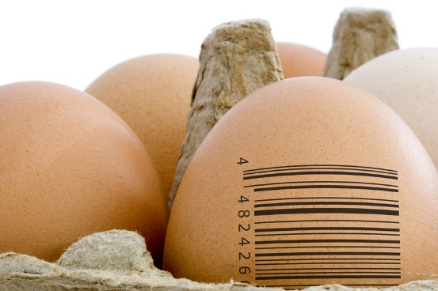
Classification
MODULE – 5

Slide 2
Classification
The problem of identifying to which category (values of a discrete variable) a new observation belongs.
Linear and Quadratic Discriminant Analysis
Logistic Regression
Neural Networks
Support Vector Machines

Slide 3
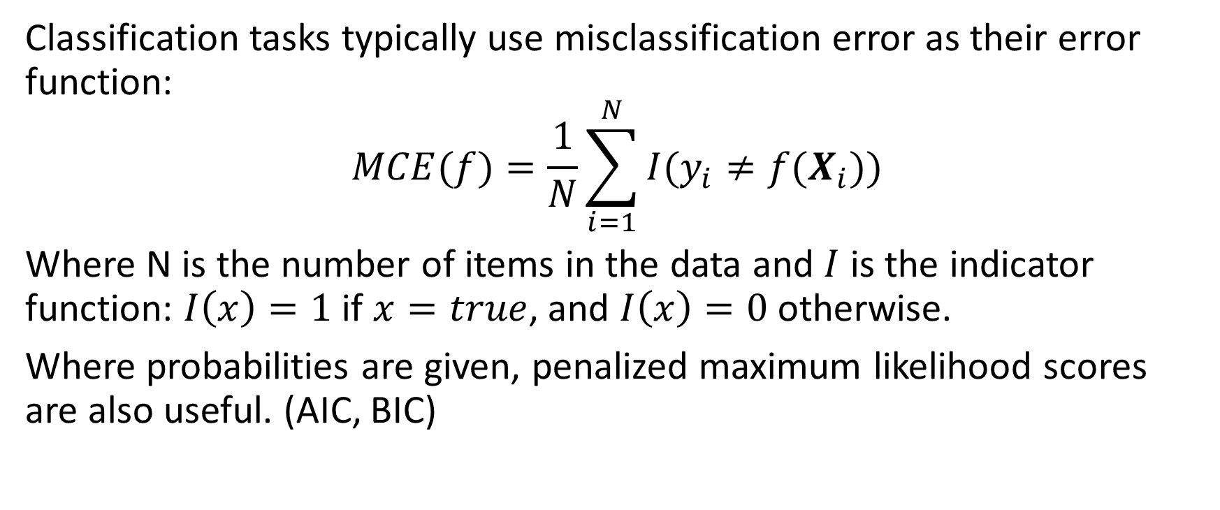
Misclassification Error
Classification tasks typically use misclassification error as their error function:
$$MCE(f)=\frac{1}{N}\sum_{i=1}^{N}{I(y_{i}≠f(X_{i}))}$$
Where N is the number of items in the data and $I$ is the indicator function: $I\left(x\right)=1$ if $x=true$, and $I\left(x\right)=0$ otherwise.
Where probabilities are given, penalized maximum likelihood scores are also useful. (AIC, BIC)

Slide 4
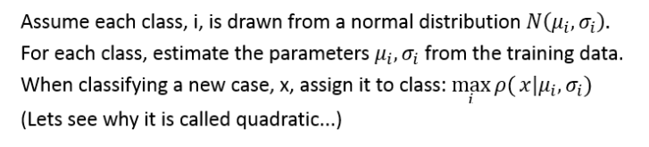
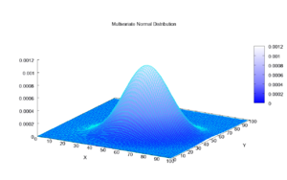
QDA: Quadratic Discriminant Analysis

Slide 5
LDA – Linear Discriminant Analysis
Assumes each class is drawn from a multivariate normal distribution with shared variance.
Covariance calculated using all points and their distance from their class means.
f
Very simple, and hence robust.
Let's see why it is called linear...

Slide 6
LDA and QDA classification
Constructors:
lda
qda
Both are in the MASS package
Important Tuning Parameters:
None
Example:
model=lda(Y~.,trainingData)
model=qda(Y~.,trainingData)
est=predict(model,newData)

Slide 7
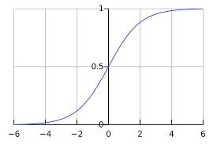
Logistic Regression
The odds of an event, n, are: $\frac{P(n)}{1−P(n)}$
The logit function is the natural log of the odds.

Slide 8
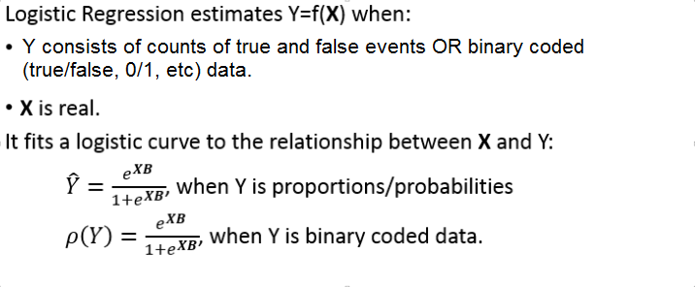
Logistic Regression

Slide 9
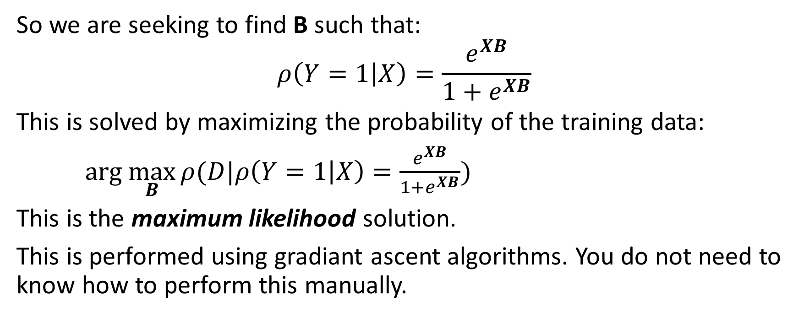
Logistic Regression
So we are seeking to find B such that:
$$ρ\left(Y=1 | X\right)=\frac{e^{XB}}{{1+e}^{XB}}$$
This is solved by maximizing the probability of the training data:
$arg \max_{B}{ρ(D|ρ\left(Y=1 | X\right)=\frac{e^{XB}}{{1+e}^{XB}})}$
This is the maximum likelihood solution.
This is performed using gradiant ascent algorithms. You do not need to know how to perform this manually.

Slide 10
Logistic Regression
Multinomial generalization:
We introduce additional sets of coefficients for each additional class and the learn the maximum likelihood value for them all at once.
$P\left(Y_{i}=n\right)$ $=\frac{e^{X_{i}B_{n}}}{1+\sum_{j=1}^{K−1}{e^{X_{i}B_{j}}}}$ , $n<K$
$=\frac{1}{1+\sum_{j=1}^{K−1}{e^{X_{i}B_{j}}}}$ , otherwise

Slide 11
Logistic Regression
Constructor:
glm
Important Tuning Parameters:
Constructor:
We must specify the link function to use using the family argument. Unusually, this comes between the formula and training data. For logistic regression the link function is "binomial".
Predict function:
By default the output of the predict function when using a glm model are transformed values. In the Poisson case, we get the logarithm of the target variable. To instead get the actual value of the target variable we must specify type="response".
Example:
model=glm(Y~.,"binomial",trainingData) # Y is 0/1
model=glm(cbind(Y,Total-Y)~.,"binomial",trainingData) # Y is counts with total possible
est=predict(model,newData,type="response")

Slide 12
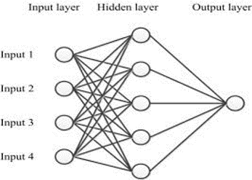
Neural Networks (Classification)
Neural networks provide a way of learning optimal non-linear transformations from the training data.
They consist of:
An input layer, representing the input features
One or more hidden layers, each of which is just a new set of variables that are a non-linear transformation of the previous layer
An output layer, which in the classification case just estimates the target variable by performing logistic regression on the final hidden layer. When the target is multinomial, this is often called 'softmax'.

Slide 13
Neural Networks (Simple)
Constructor:
nnet (in package nnet)
NB For advanced deep learning, use package mxnet. See our Applied Deep Learning with MXNetR Workshop.
Important Tuning Parameters:
Constructor:
size: Number of nodes in the hidden layer. Only one hidden layer permitted.
maxit: Maximum iterations to use for training. Default is 100.
linout: Should the output layer be a linear regression layer. Should be FALSE for classification models. Default is FALSE.
decay: L2 regression parameter. Default is 0.
Example:
model=nnet(Y~X,trainingData,size=10)
model=nnet(Y~X,trainingData,size=10,maxit=10000,decay=.1)
est=predict(model,newData)

Slide 14
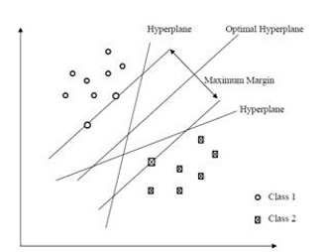
Support Vector Machines
Optimal Separating Hyperplane
Separable Case
The hyperplane that maximizes the margin between itself and the closest points of each class.

Slide 15
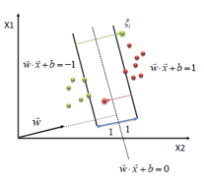
Support Vector Machines
Optimal Separating Hyperplane
Inseparable Case
Use a cost hyperparameter, C
Points over their class margin declared abnormal and incur a cost depending on C and the distance from the margin.
The hyperplane that maximizes the margin between itself and the closest normal points of each class and minimizes the cost of abnormal points.

Slide 16
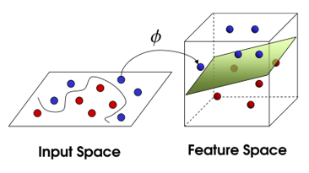
Support Vector Machines
Project to new, higher dimensional spaces where the classes are more likely to be separable.
Projections use kernel functions which often have their own tuning parameters.
A 'linear kernel' performs no projections

Slide 17
SVMs
Constructor:
svm (in package e1071)
Important Tuning Parameters:
Constructor:
cost – The cost hyper-parameter
type (we only look at C classification, which is the default, other approaches are possible)
kernel – The kernel to use for the projection. Options are linear, radial, polynomial and sigmoid. Radial is the default. The equations are given in the help documentation. Tuning hyper-parameters for these kernels are:
  gamma (radial, polynomial and sigmoid)
  coef0 (polynomial and sigmoid)
  degree (polynomial)
cross – If you give an integer larger than 0 then cross-validation will be performed on the model.
Example:
model=svm(Y~X,trainingData,type="C",gamma=1,cost=1)
model=svm(Y~X,trainingData,type="C",kernel="linear",cost=1)
est=predict(model,newData)

Slide 18
SVMs
It is generally essential to tune SVM hyper-parameters carefully.
Hyper-parameter tuned constructor:
Tune.svm (in package e1071)
Important Tuning Parameters:
Constructor:
As normal constructor but give vectors of cost and kernel tuning parameters. The best model is returned in the field best.model.
Example:
res=tune.svm(Y~X,trainingData,type="C",gamma=(1/(ncol(trainingData)-1))*2^(-2:2),cost=2^(-2:2))
est=predict(res$best.model,newData)

Slide 19
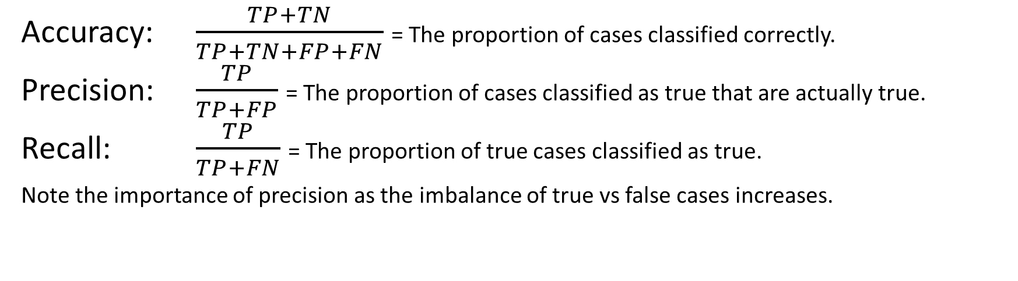
Confusion Matrices, Precision and Recall
 | Predicted: True | Predicted: False
Actual: True | True Positives (TP) | False Negatives (FN)
Actual: False | False Positives (FP) | True Negatives (TN)
Accuracy: $\frac{TP+TN}{TP+TN+FP+FN}$ = The proportion of cases classified correctly.
Precision: $\frac{TP}{TP+FP}$ = The proportion of cases classified as true that are actually true.
Recall: $\frac{TP}{TP+FN}$ = The proportion of true cases classified as true.
Note the importance of precision as the imbalance of true vs false cases increases.

Slide 20
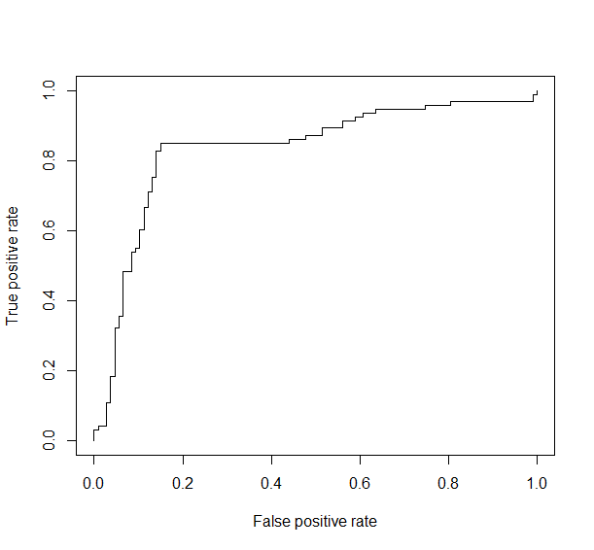
Balanced Accuracy & ROC
Unbalanced classes can cause problems
  Normally: high accuracy, low precision
Useful to optimize alternative accuracy measures.
  F1, (single or both ways)
  Distance from the X=Y curve on an ROC
ROC curves also used for optimizing thresholds in binary optimizations
  LDA, QDA, Logistic regression implicitly thresholds at .5 in the binary case
  roc.area and roc.plot functions in the verification package
    They require a vector of true classes (should be binary), and a vector giving the classifiers scores

Slide 21
Classification Exercises
Use the Sonar data in mlbench.
Split the data into training, evaluation and test data sets.
Create lda, qda, logistic regression, neural network and svm models.
Evaluate these models using the evaluation data and select the best.
Evaluate the final model using the test data and view a confusion matrix of the model's performance on this data (use createCM from datasets.h).

